Slide 1


Slide 2

Topics
Introduction to Radar and Pie charts
Anomaly detection and its removal
Ensemble Methods
Bagging, Boosting
Hands-on Activity: News Clustering

Slide 3
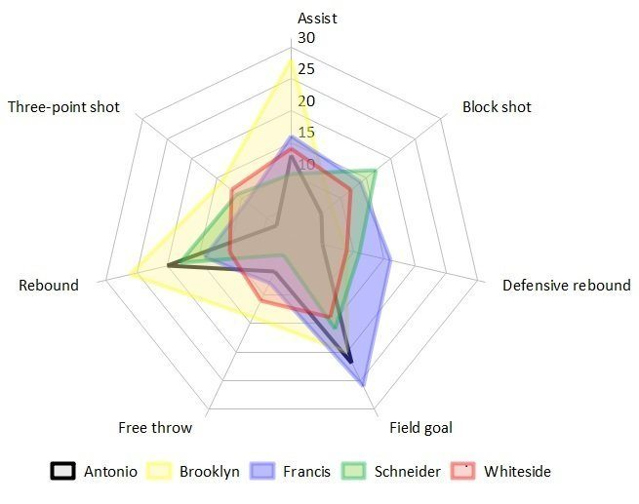
Radar Charts
A Radar chart is an informative visual tool in which multiple variables (three or more) and compared on a two-dimensional plane. For this, we will create different axes emerging from a common central point.
Notes:
Also knows as Spider/Web chart.

Slide 4
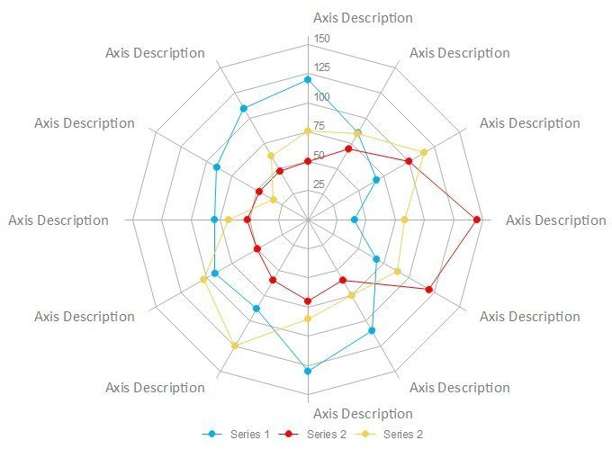
Elements of Radar Charts
Center point: This is the core of a spider chart (at the center) from which different axes are drawn.
Axis: Each axis represents a variable in a radar chart and is given a name and different values. A radar graph has at least 3 axes.
Grids: When axes are linked in a spider chart, it divides the entire graph into different grids that help us represent information in a better way.
Values: Once the graph is drawn, we represent various values on each axis and plot the chart for every entry by allocating distinctive colors.
Notes:
Ideally, a spider (radar) chart can be used in any situation when you need to represent multivariable information in a 2D plane. Though, the concept of a radar graph is mostly used in these cases:
Comparison of entities: A spider graph can help us compare different products and concepts in a single diagram. We can distinguish different entities through color- coding.
Analysis: A radar chart can also help us understand a concept and how its value is changed over different parameters. For instance, you can analyze the market performance of a product over time.
Decision-making: Since a spider chart can depict so much information in one place, it can help you make data-driven decisions easily.
Other applications: Apart from that, a radar graph can also work as an ideal visual aid. It can play a vital role in different sectors like marketing, analysis, sales, research, education, and more.

Slide 5
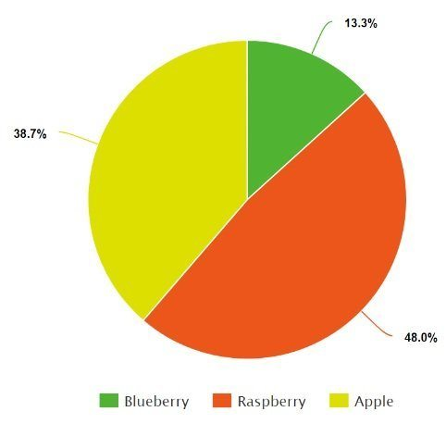
Pie Charts
A pie chart is a type of graph that represents the data in a circular graph. The slices of pie show the relative size of the data, and it is a type of pictorial representation of data. A pie chart requires a list of categorical variables and numerical variables.
Notes:
Within a business, it is used to compare areas of growth, such as turnover, profit, and exposure.
To represent categorical data.
To show the performance of a student in a test, etc.

Slide 6
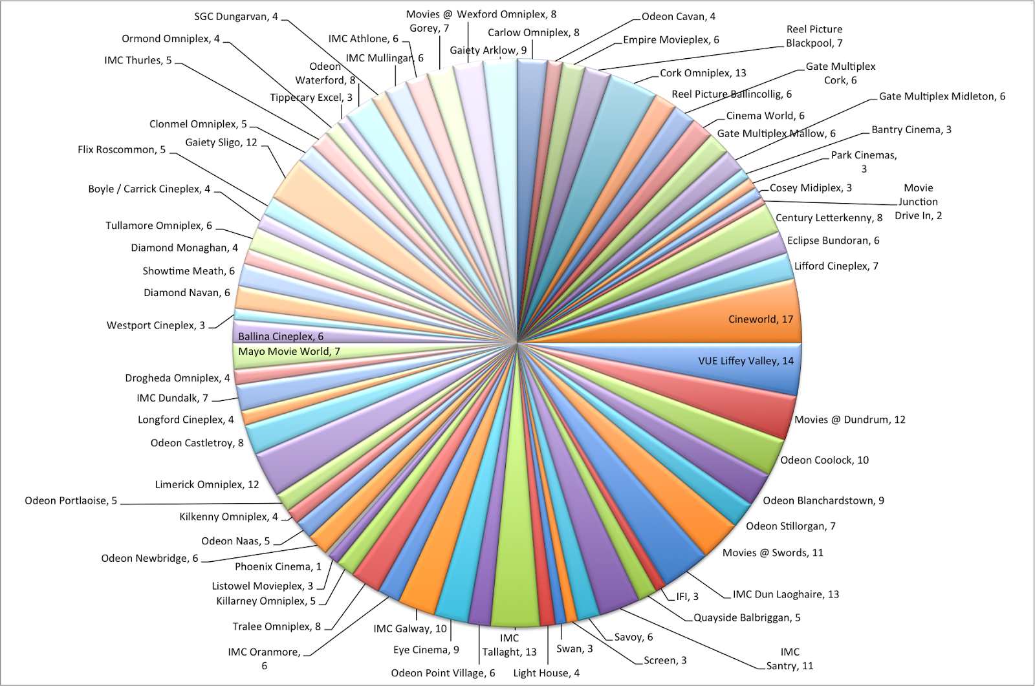
When do Pie Charts fail?
It becomes less effective if there are too many pieces of data to use. If there are too many pieces of data. Even if you add data labels and numbers may not help here, they themselves may become crowded and hard to read.

Slide 7
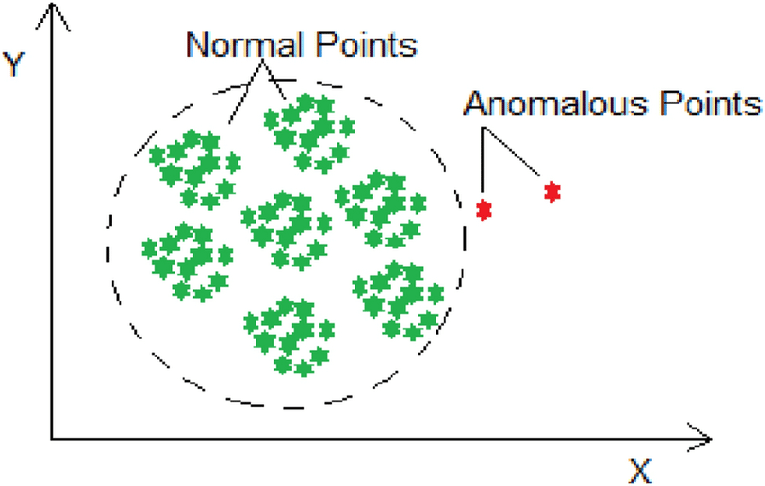
What is an Anomaly?
Anomalies are data points that stand out amongst other data points in the dataset and do not confirm the normal behavior in the data. These data points or observations deviate from the dataset’s normal behavioral patterns.
Anomaly detection is an unsupervised data processing technique to detect anomalies from the dataset.
Notes:
An anomaly can be broadly classified into different categories:
Outliers: Short/small anomalous patterns that appear in a non-systematic way in data collection.
Change in Events: Systematic or sudden change from the previous normal behavior.
Drifts: Slow, undirectional, long-term change in the data.

Slide 8
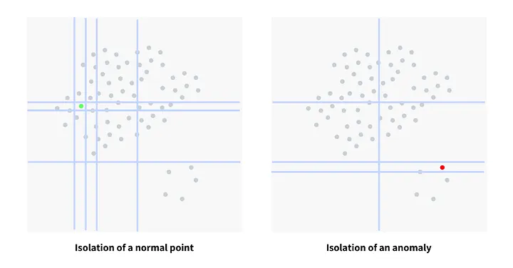
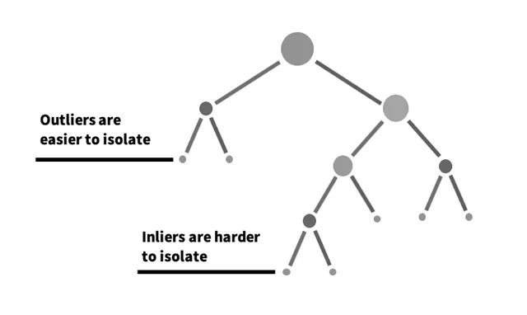
Anomaly Detection Algorithms
Isolation Forest:
Isolation Forest uses a random forest algorithm (decision trees) under the hood to detect outliers in the dataset. The algorithm tries to split or divide the data points such that each observation gets isolated from the others.
Notes:
There are many but we’ll discuss only two.
https://towardsdatascience.com/5-anomaly-detection-algorithms-every-data-scientist-should-know-b36c3605ea16

Slide 9
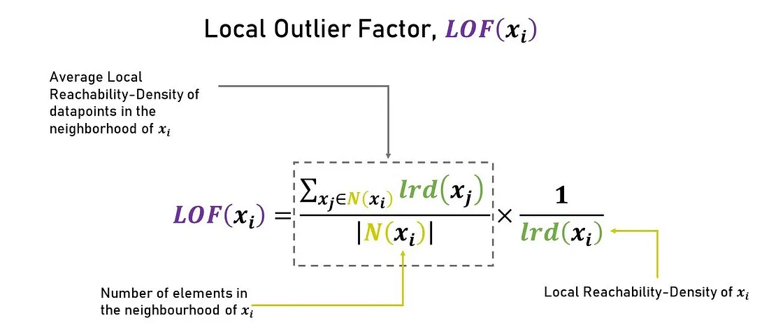
Anomaly Detection Algorithms
Local Outlier Factor
Local Outlier Factor is another anomaly detection technique that takes the density of data points into consideration to decide whether a point is an anomaly or not.
The local outlier factor computes an anomaly score called anomaly score that measures how isolated the point is with respect to the surrounding neighborhood.
Notes:
Anomaly detection algorithms are very useful for fraud detection or disease detection case studies where the distribution of the target class is highly imbalanced. Anomaly detection algorithms are also to further improve the performance of the model by removing the anomalies from the training sample.

Slide 10
Anomaly Removal
Trimming: It excludes the anomalies from our analysis. By applying this technique, our data becomes thin when more anomalies are present in the dataset. Its main advantage is its fastest nature.
Capping: In this technique, we cap our anomalous data and make the limit i.e., above a particular value or less than that value, all the values will be considered as anomalies, and the number of anomalies in the dataset gives that capping number.
Treating anomalies as a missing value: By assuming anomalies as the missing observations, treat them accordingly, i.e., same as missing values imputation.
Discretization: In this technique, by making the groups, we include the anomalies in a particular group and force them to behave in the same manner as those of other points in that group. This technique is also known as Binning.

Slide 11
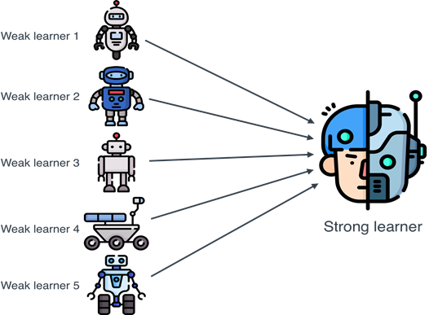
Ensemble Methods
Ensemble methods are techniques that aim at improving the accuracy of results in models by combining multiple models instead of using a single model. The combined models increase the accuracy of the results significantly.

Slide 12
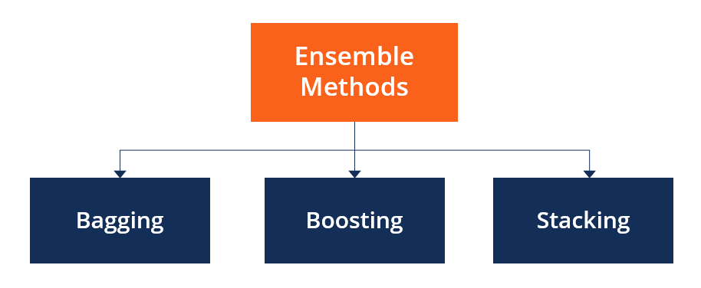
Types of Ensemble Methods
Ensemble methods are techniques that aim at improving the accuracy of results in models by combining multiple models instead of using a single model. The combined models increase the accuracy of the results significantly.
Homogenous Ensemble Methods
Heterogenous Ensemble Methods
Notes:
Very roughly, we can say that bagging will mainly focus at getting an ensemble model with less variance than its components whereas boosting and stacking will mainly try to produce strong models less biased than their components (even if variance can also be reduced).

Slide 13
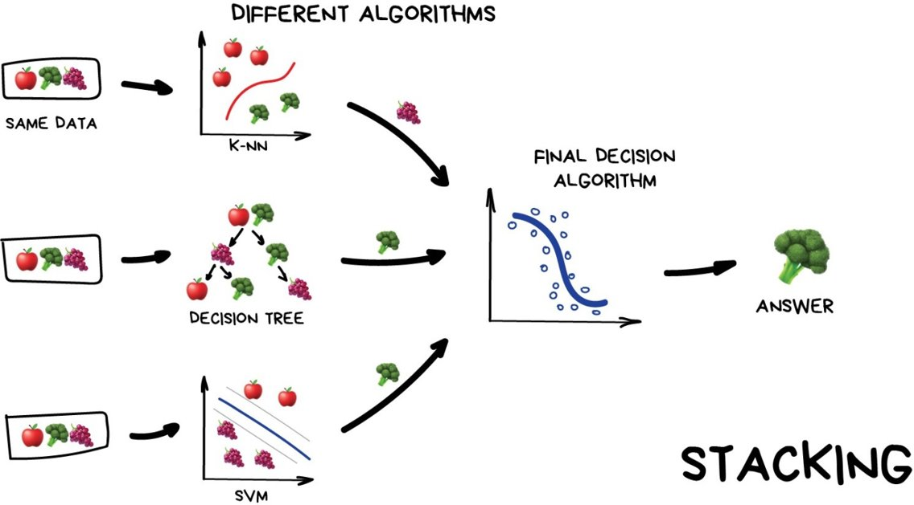
Heterogenous Ensemble Methods: Stacking
Stacking is often referred to as stacked generalization. This technique works by allowing a training algorithm to ensemble several other similar learning algorithm predictions.
Notes:
Stacking has been successfully implemented in regression, density estimations, distance learning, and classifications.

Slide 14
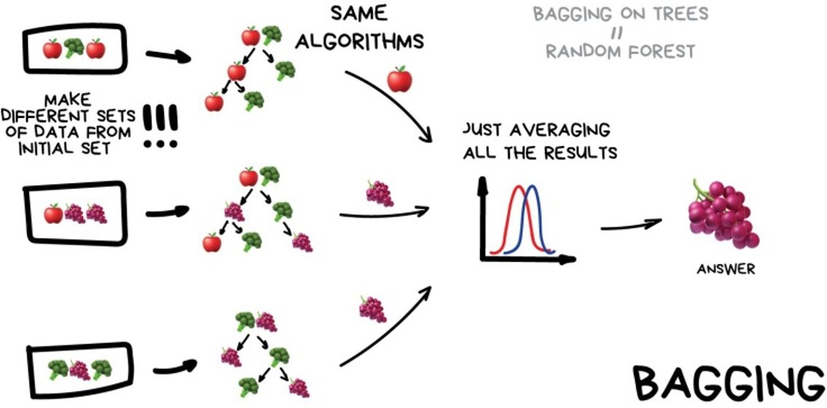
Homogenous Ensemble Methods: Bagging
BAGGing, or Bootstrap AGGregating. BAGGing gets its name because it combines Bootstrapping and Aggregation to form one ensemble model. Given a sample of data, multiple bootstrapped subsamples are pulled. A Decision Tree is formed on each of the bootstrapped subsamples.

Slide 15
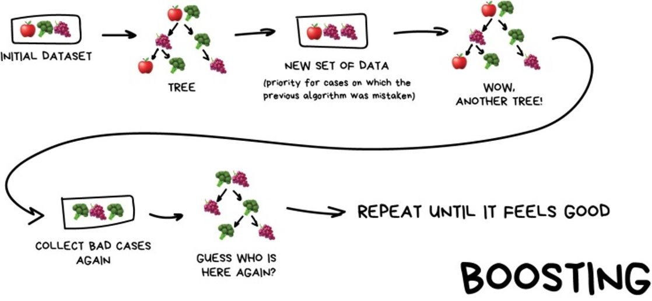
Homogenous Ensemble Methods: Boosting
Boosting is an ensemble technique that learns from previous predictor mistakes to make better predictions in the future. The technique combines several weak base learners to form one strong learner, thus significantly improving the predictability of models.
Notes:
Boosting takes many forms, including gradient boosting, Adaptive Boosting (AdaBoost), and XGBoost (Extreme Gradient Boosting). AdaBoost uses weak learners in the form of decision trees, which mostly include one split that is popularly known as decision stumps. AdaBoost’s main decision stump comprises observations carrying similar weights.
Gradient boosting adds predictors sequentially to the ensemble, where preceding predictors correct their successors, thereby increasing the model’s accuracy. New predictors are fit to counter the effects of errors in the previous predictors. The gradient of descent helps the gradient booster identify problems in learners’ predictions and counter them accordingly.
XGBoost makes use of decision trees with boosted gradient, providing improved speed and performance. It relies heavily on the computational speed and the performance of the target model. Model training should follow a sequence, thus making the implementation of gradient boosted machines slow.

Slide 16
Types of Boosting
XGBoost
XGBoost is a scalable and flexible boosting algorithms optimized for performing
data science tasks.
XGBoost has the capacity for handling missing data and regularization.
XGBoost based models have won many machine learning challenges.
CatBoost
Categorical + Boosting (CatBoost) is an algorithm that produces good results even without extensive hyperparameter tuning.
CatBoost has the inbuilt capacity to handle categorical features even non-numerical ones.
CatBoost offers improved performance as it reduces overfitting when building models.
AdaBoost
AdaBoost (Adaptive Boosting) is a machine learning meta-algorithm that is less susceptible to overfitting problems than other learning algorithms.
AbaBoost is sensitive to noisy data and outliers.
AdaBoost was designed to put more weight on misclassified samples and less weight on correctly classified samples. The final prediction is a weighted average of all the weak learners, where more weight is placed on strong learners.
LightGBM
LightGBM is built for model training speed and churning high-performing models.
LightGBM is capable of handling big data with its in-built parallel computing capacity.
LightGBM is optimized for low memory usage.

Slide 17

THANK YOU
Training and Certification

